Slide 1
Overview of the MyDesign App

Slide 2
MyDesign Features
Student and Teacher Sign Up and Log In
Class Management
Student Design and Work Product Release
Teacher Assessment of Released Work Products
Progress Review
Workshop All
Workshop #3 & 4
Workshop #2
Workshop #1 & 3

Slide 3
Workflow for Design, Assessment and Progress Review
Sign-up & Login
Use MyDesign Guidance and Resources to Create & Release Design Work
Create/Select Project
Select Design Component
Student
Class/Team Management
Student: Review Progress & Assessment
Sign-up & Login
Select Class
Assess Student Work
Student Login
Student Design
Teacher Login
Teacher
Teacher Grading
Reflect and Iterate

Slide 4
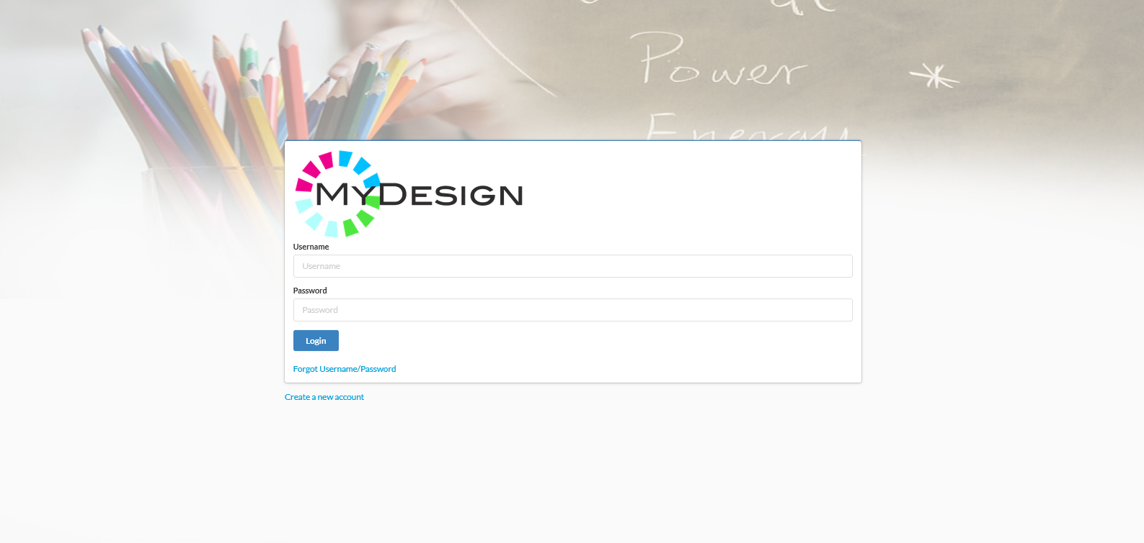
Login Screen
Other screens exist for recovering username and password
Select to access the Sign Up screen and create an account
Successful login draws user data from the database, including user type (student or teacher)

Slide 5
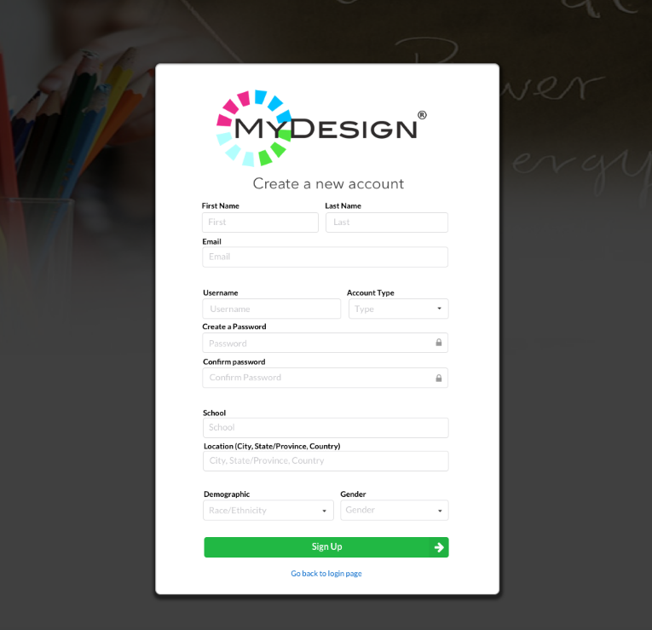
Sign Up Screen
Login information and demographics
Additional dropdown menu to be added for grade level:
Elementary School
Middle School
High School
Post-Secondary
Professional
User Type Dropdown Menu:
Student
Teacher
Select “SIGN UP” to create the account and login

Slide 6
Student Screens

Slide 7
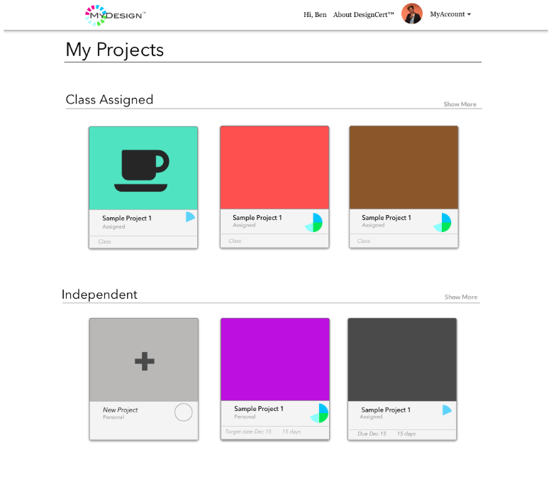
Project Select Screen
Select a project to work on or review
Select to create a new project. The Project Create screen is the same for students and teachers
The student can work on projects assigned in classes or independent projects outside of the classroom

Slide 8
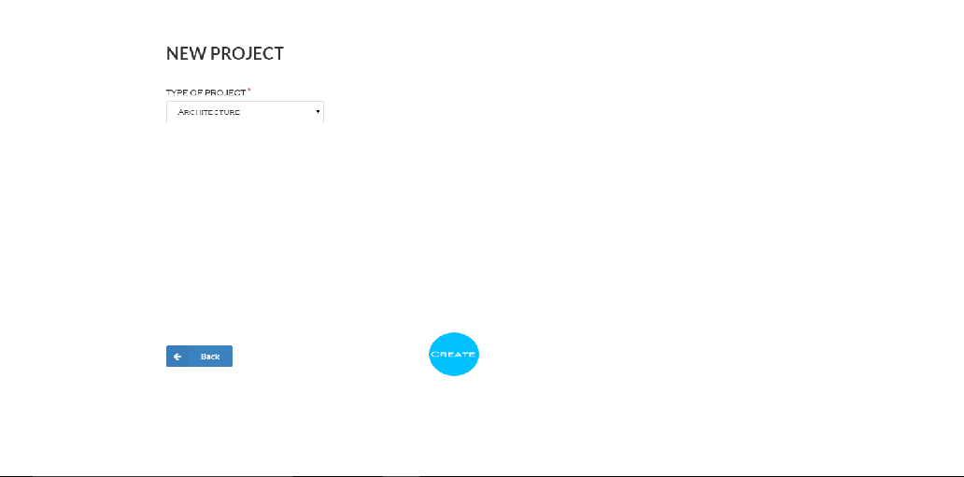
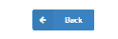
Project Create Screen
Project Type Dropdown Menu:
Architecture
Civil & Agricultural Engr
Electrical & Electronic Engr
Floral & Fashion Engr
Graphic Design
Mechanical Engr & Structures
Network & Database Design
Room Design
Software Engr & Programming
Other Design
Project Name:
Project Description:
Enter project descriptive information
Select CREATE to save the new project and return to Project Select screen

Slide 9
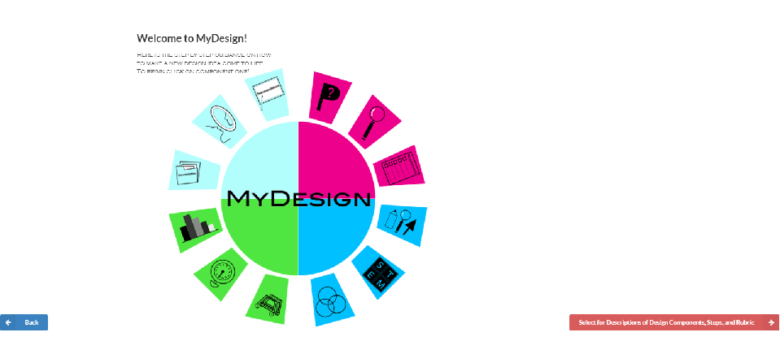
Design Component Select Screen
Note: we are currently working to embed this screen in the Student Dashboard
Select to select one of four design components
Select to review rubric

Slide 10
Introduction to the Engineering Design Process Portfolio Scoring Rubric
Rationale for the Rubric
PLTW Innovation Portal
Graphical Rubric for MyDesign

Slide 11
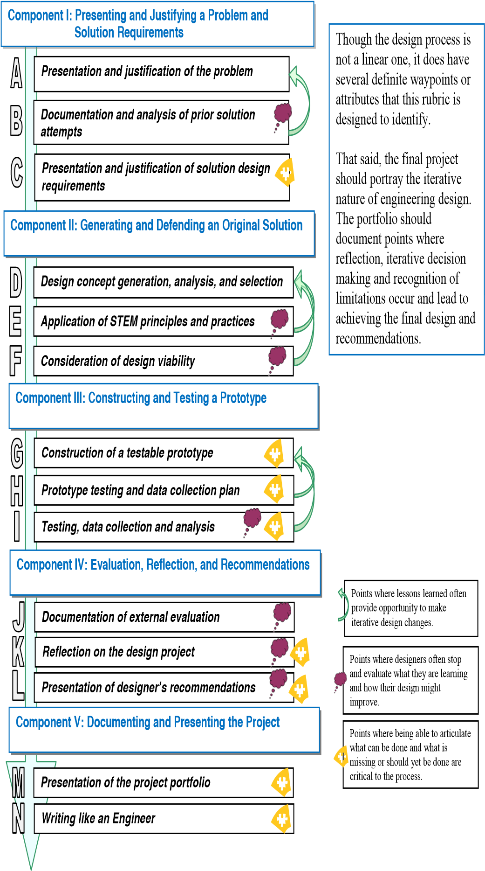
Engineering Design Process Portfolio Scoring Rubric (EDPPSR)

Slide 12
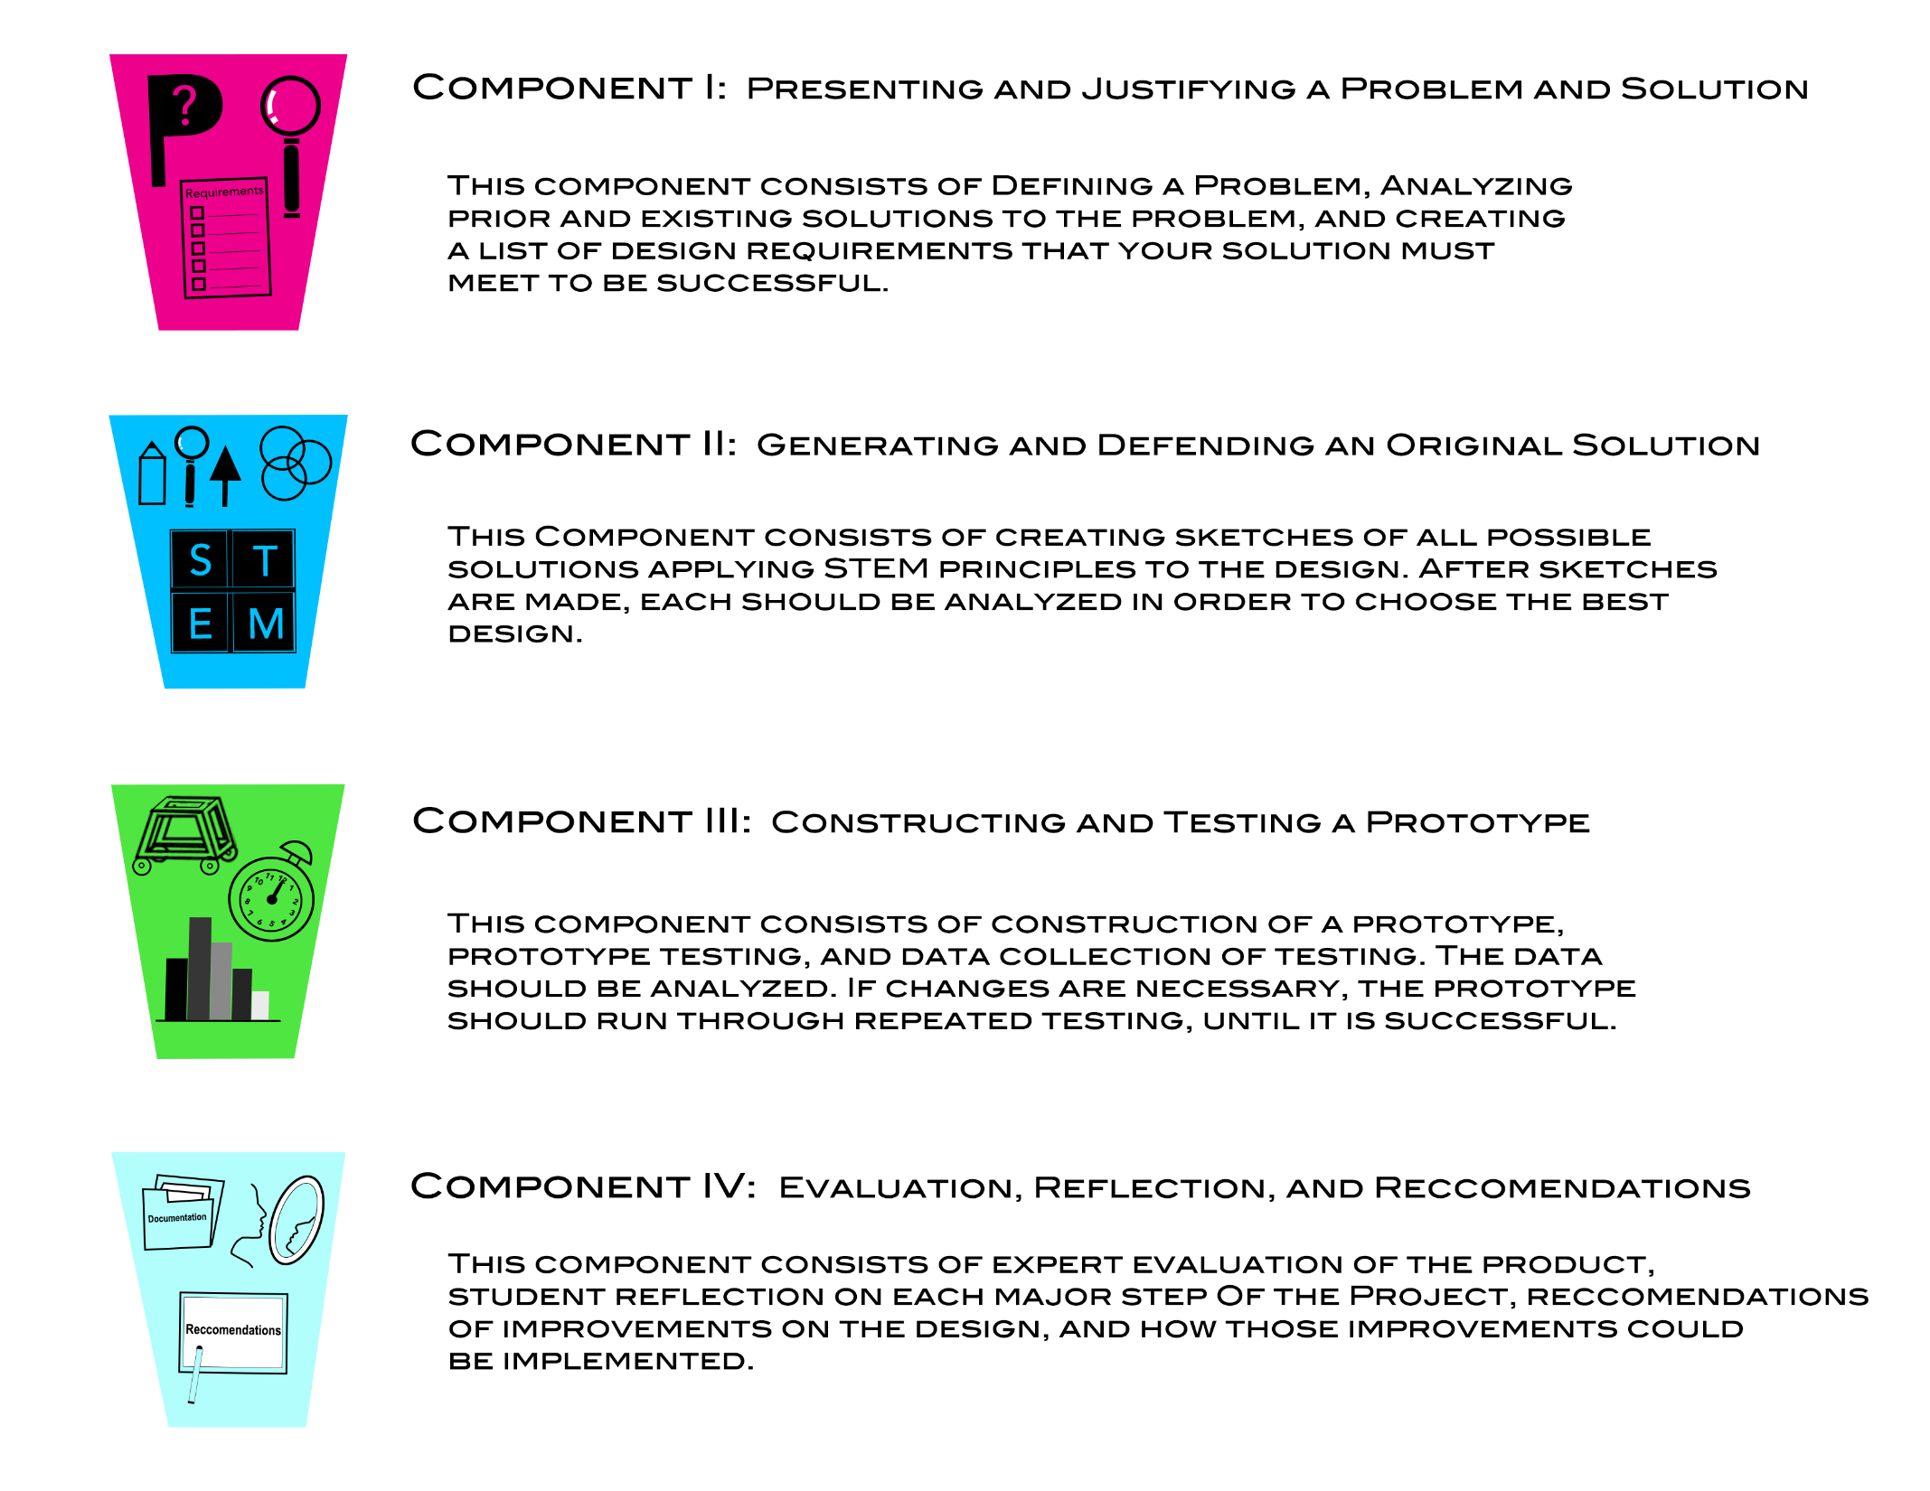
Descriptions of each of the four Design Components. Select to see Design Steps for each
Information in this and the following two screens are available from either the Student or Teacher Dashboard

Slide 13
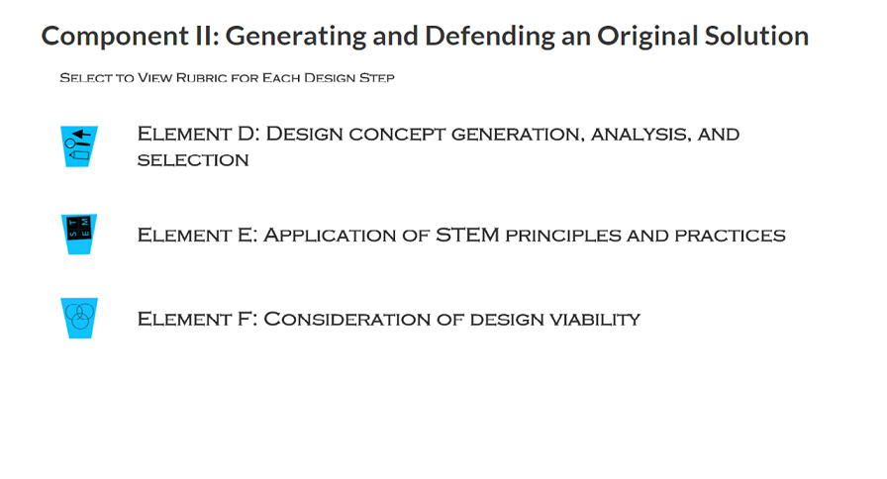
Representative example of Design Steps within a Design Component. This example is for Component II. Select to view rubric for each step.

Slide 14
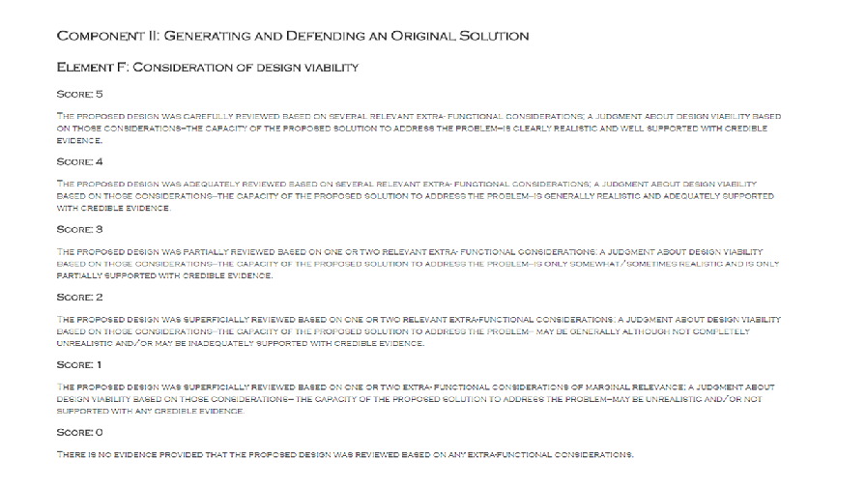
Representative example of Rubric for each Design Step within a Design Component. This example is for Component II, Design Step F.

Slide 15
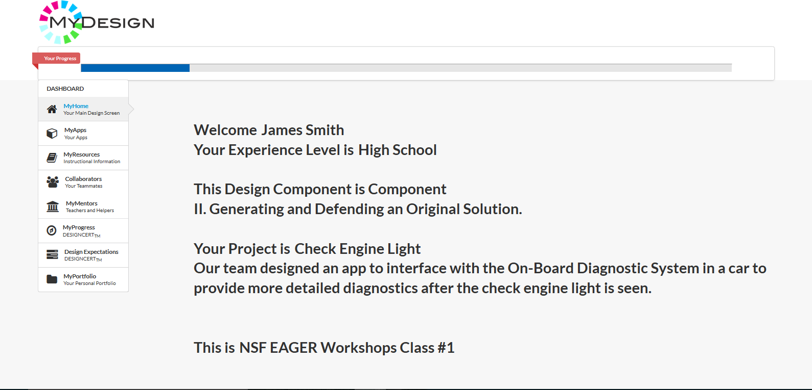
Student Dashboard Screen
Progress Bar
Design Guidance:
EDPPSR
3rd Party Apps
Examples/Resources/Tutorials
Collaboration
Work Product Release
Progress Review

Slide 16
3rd Party Application Access Screens

Slide 17
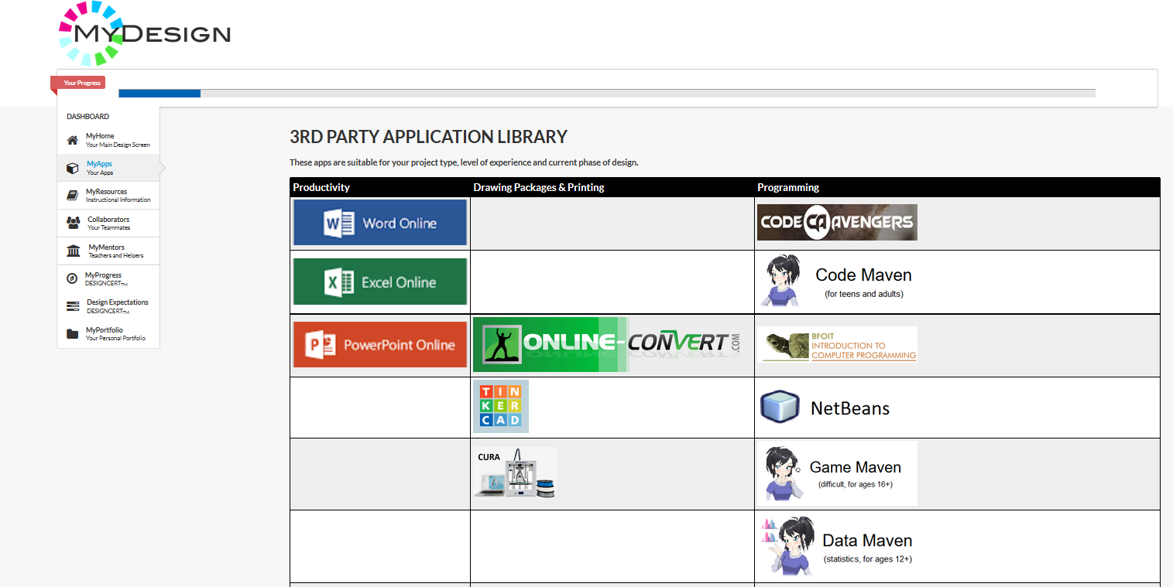
3rd Party App Recommendations Panel
Selecting app icon launches 3rd party app
Selection of MyApps displays a set of 3rd Party Applications recommended for:
Student Age
Project Discipline
Phase of Design

Slide 18
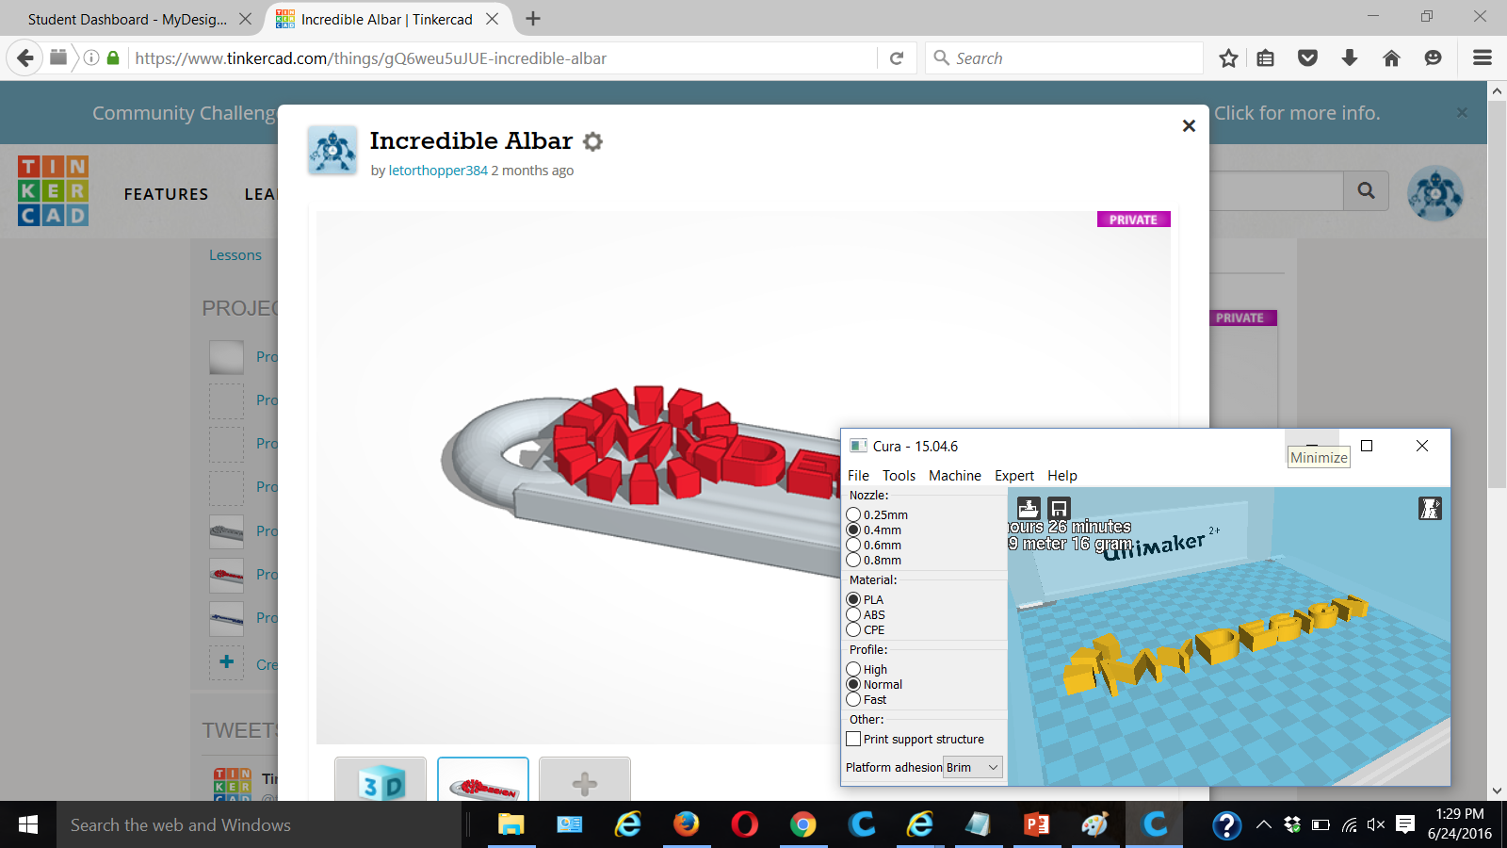
3rd Party App Screens
These 3rd party apps support creation of 3D models and interface to the Ultimaker 2+ 3D printer
3rd party apps launched from MyDesign
Documents created through the use of 3rd party apps can be saved to the student portfolio

Slide 19
Student Portfolio Work Product Release Screens

Slide 20
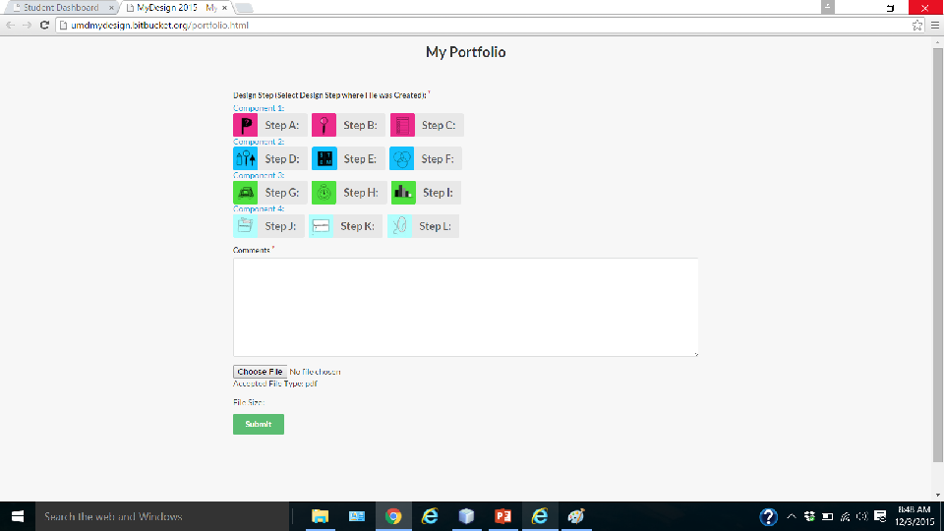
Portfolio Storage (i.e., Work Release) Screen
Screen appears in separate tab
Add comments
Mouse-over rubric (design step) icons to view descriptions and click on design step to be associated with work product released for review
Select “Choose File” to browse directories for work product to release

Slide 21
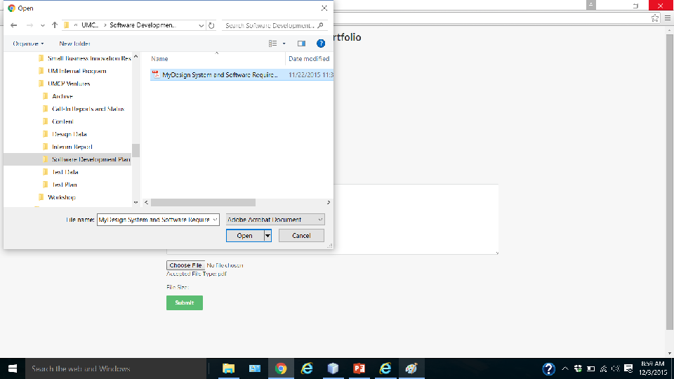
Portfolio Storage Screen (with directory browser)
Browse through directories and select a file to download
Select “Open” for selected file

Slide 22
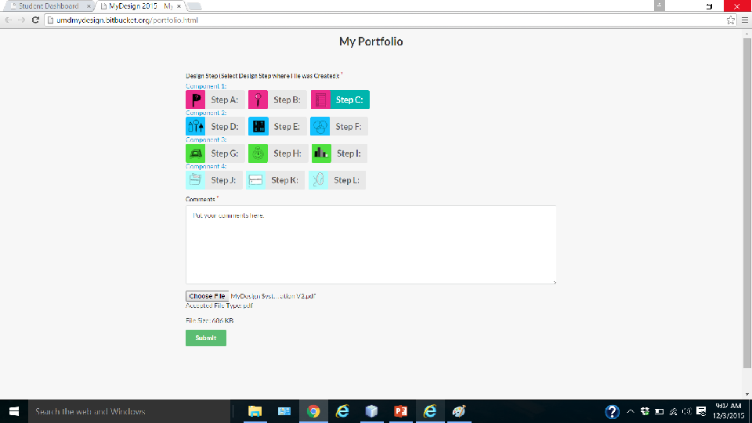
Portfolio Storage Screen (ready to submit)
Step C selected
(Optional) comments added
File: must be PDF and less than 2 MB size
Select “Submit” to release document for review

Slide 23
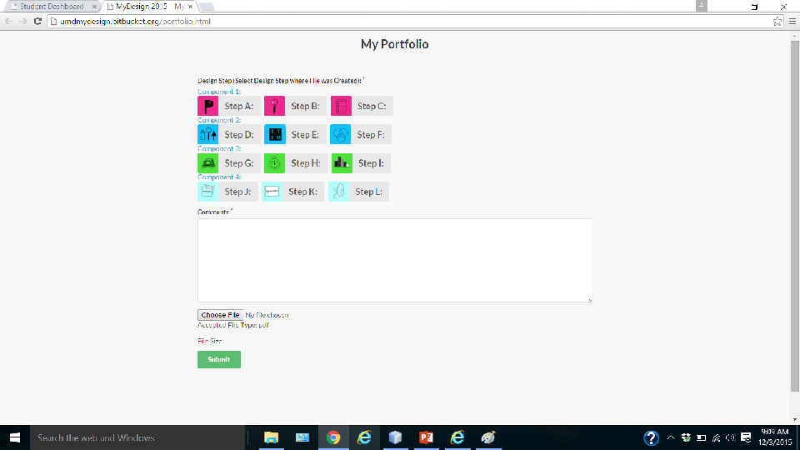
Portfolio Storage Screen (after successful submit)
Screen is cleared of data
Save another work product or exit Portfolio Storage tab and reselect Student Dashboard tab to continue work

Slide 24
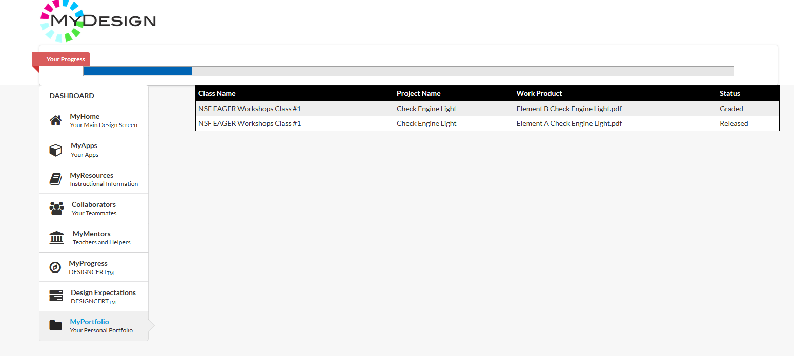
Portfolio Status
After returning to the Student Dashboard, the Student is presented with a table of all products released and their status (just released or graded)

Slide 25
Student Progress Review Screens

Slide 26
Student Dashboard Performance Review
Percentage of Design Steps with at least on work product released
Select to show progress panel

Slide 27
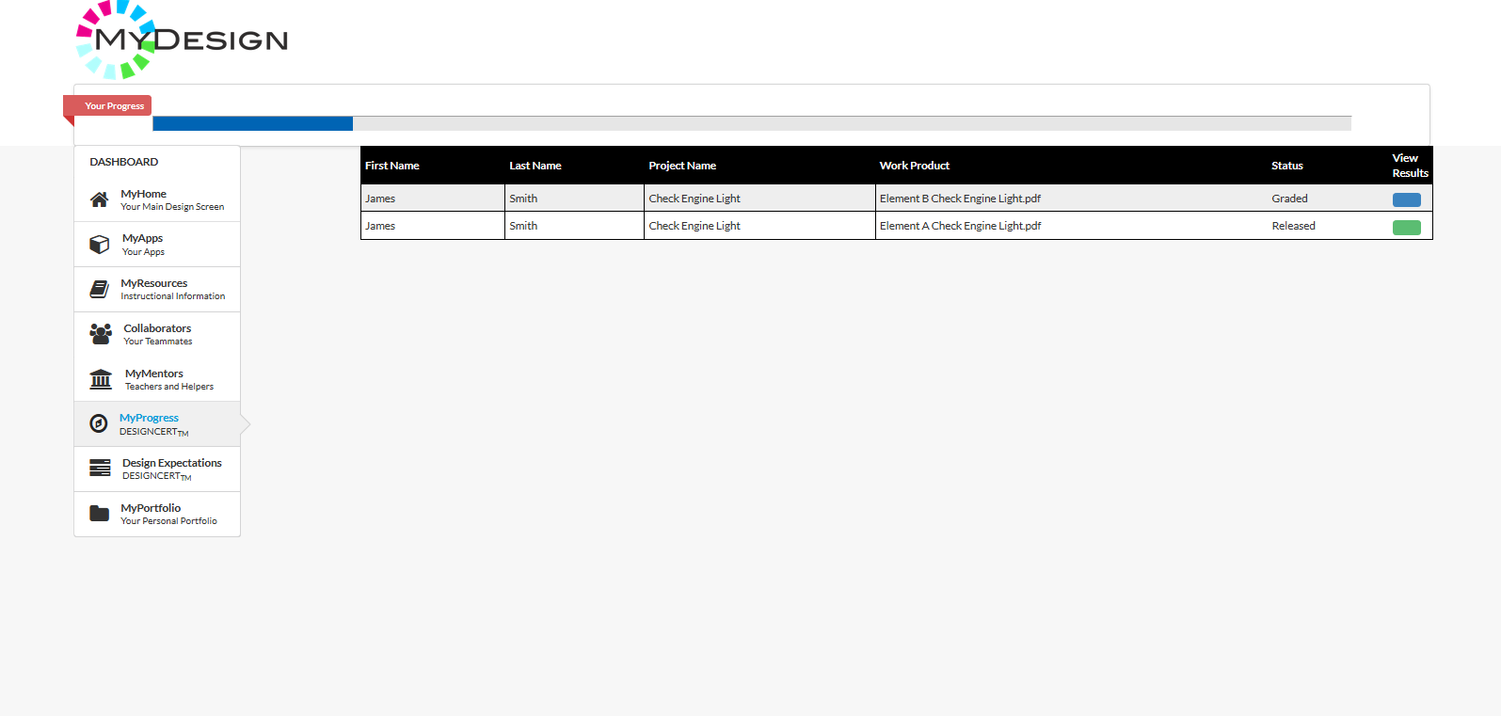
Released Work Product Review
Select to view assessment scores on the work product assessment panel

Slide 28
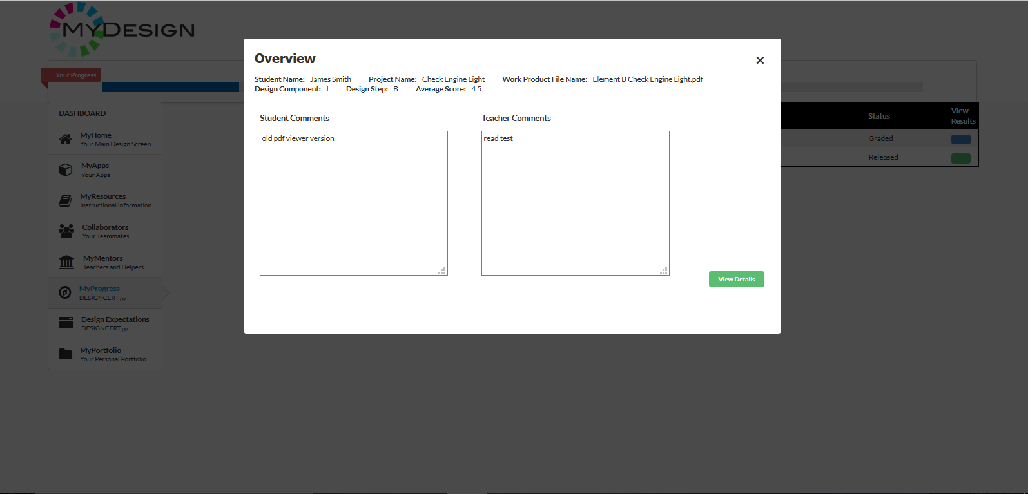
Overview of Work Product Assessment
Work Product Metadata
Select to view details of score
Student and Teacher comments and overall score

Slide 29
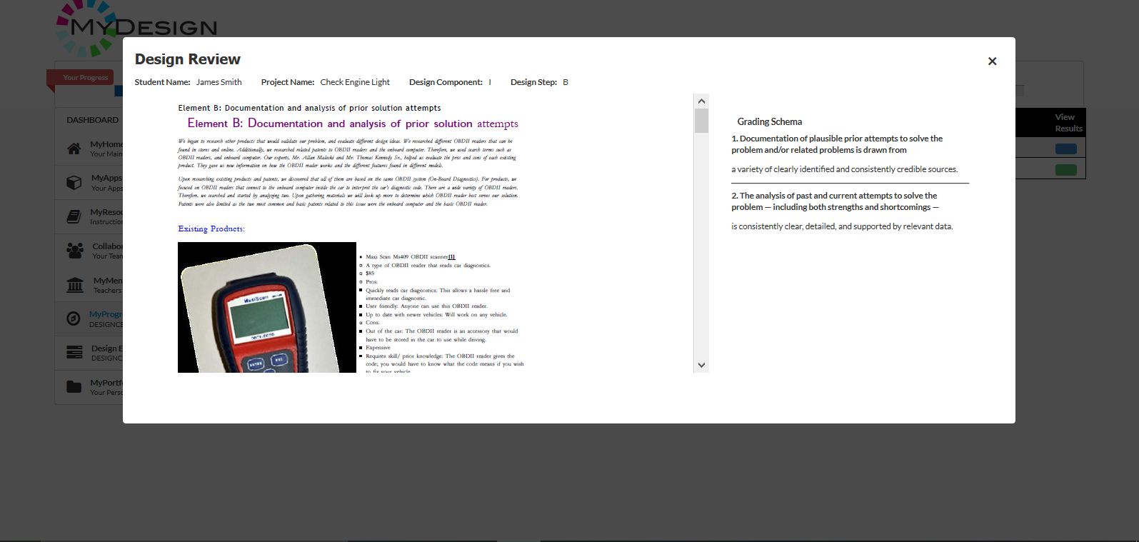
Details of Work Product Assessment
Work Product Metadata
Work Product PDF File
Details of assessment against rubric

Slide 30
Teacher Screens

Slide 31
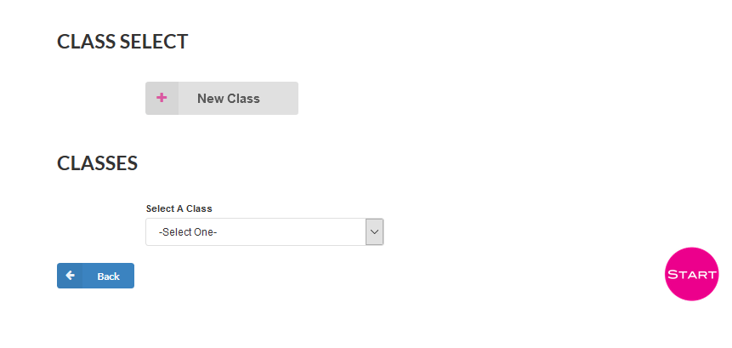
Class Select Screen
Selection of New Class loads the New Class Description panel on the Teacher Dashboard page
Makes data available for selected class
Select from list of classes for this session
Note: we are working to embed this screen into the Teacher Dashboard

Slide 32
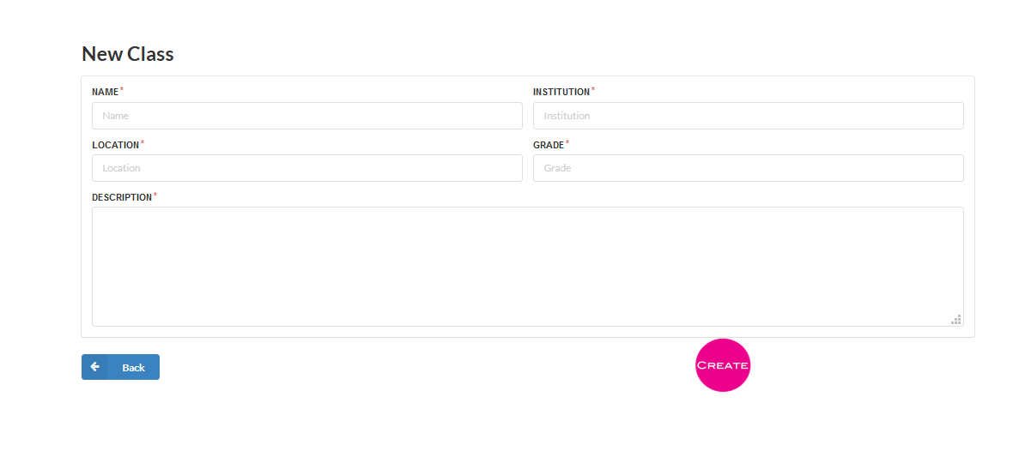
Class Creation Screen
Adds new class to list and returns to Class Select panel
Note: this will become a pop up in the Teacher Dashboard screen

Slide 33
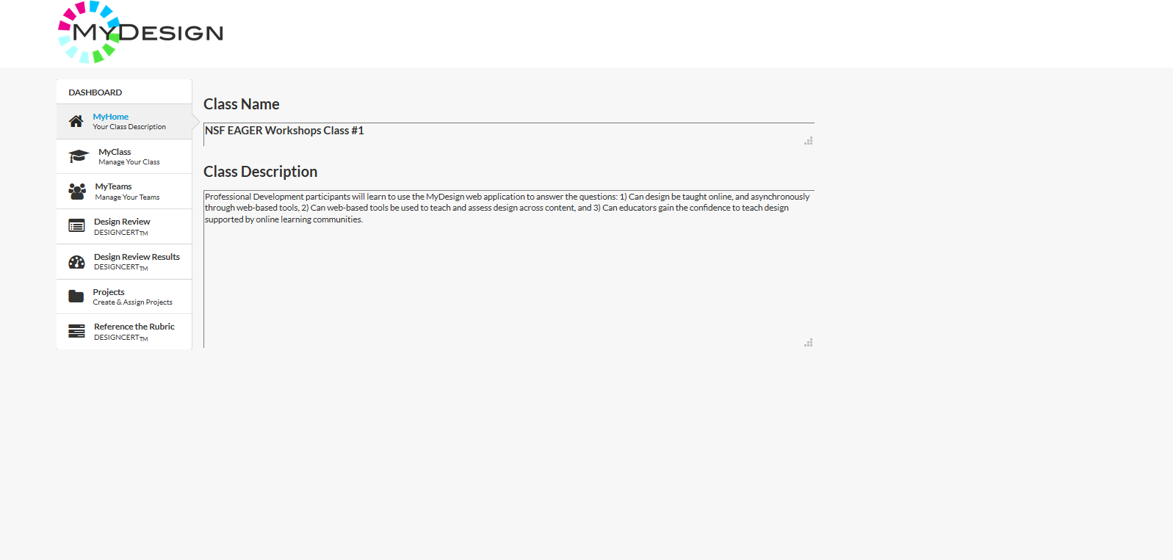
Teacher Dashboard Screen Home Panel
Teacher Dashboard
Class Identification
Student Class Roster
StudentTeam Rosters
Student Project Assignments
Design Work Product Scoring
EDPPSR
Teacher Dashboard
Class & Team Management
Progress Review
Released Work Product Assessment
Project Creation
EDPPSR

Slide 34
Class Management Screens

Slide 35
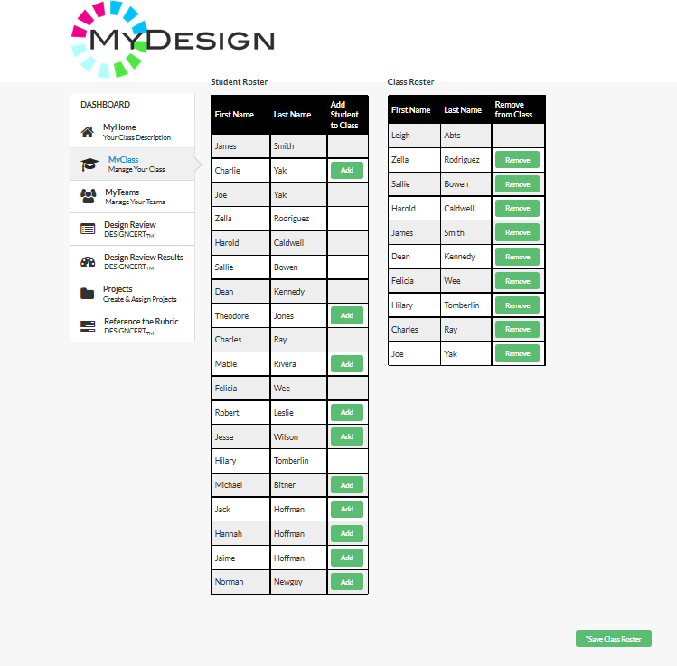
Class Roster Panel
Remove students from class by selecting Remove boxes Save Class Roster
Enroll students in class by selecting Add boxes and Save Class Roster
Save Class Roster button saves to database

Slide 36
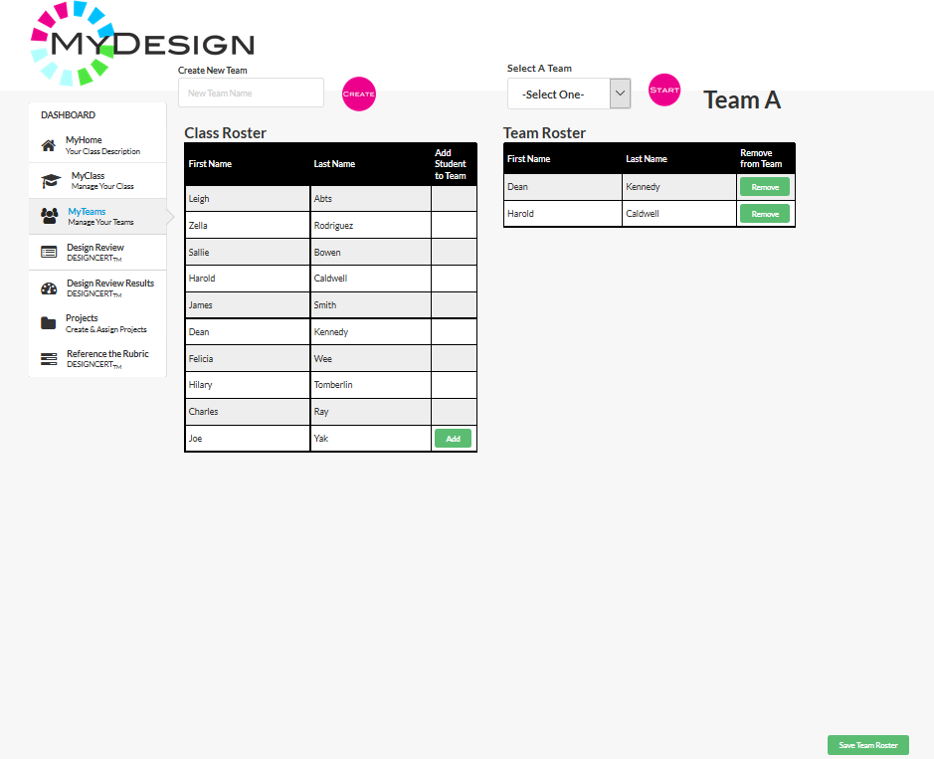
Team Roster Panel
Create new teams and add them to the dropdown list for viewing and editing
Remove students from team by selecting Remove boxes Save Team Roster
Enroll students in team by selecting Add boxes and Save Team Roster
Save Team Roster button saves to database

Slide 37
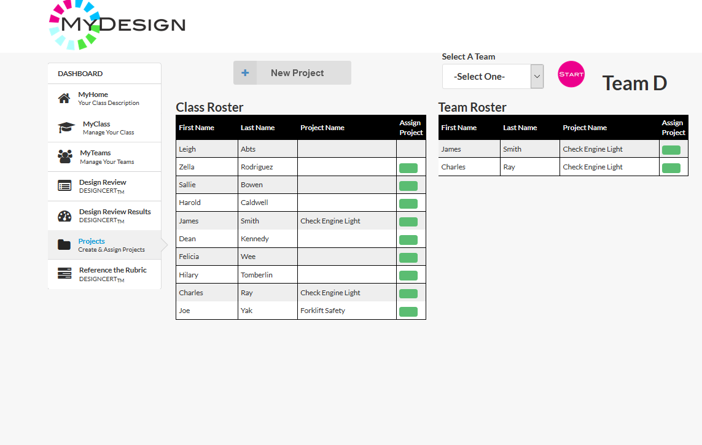
Project Assignment Panel
Select to access Assign Projects panel
New Project button navigates to the same Project Creation screen as used by the students. Student created projects are independent. Teacher created projects can be assigned to anyone in the class/team
Save Project Assignments saves to the database

Slide 38
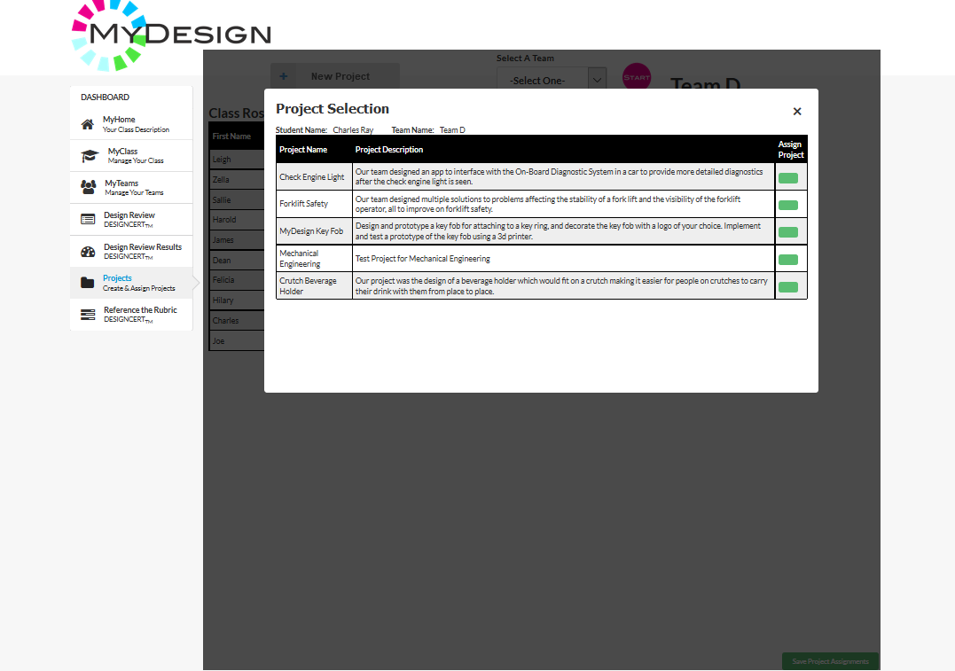
Assign Projects Panel
Any Teacher created project is available to be assigned to students

Slide 39
Grading Student Work from the Teacher Dashboard

Slide 40
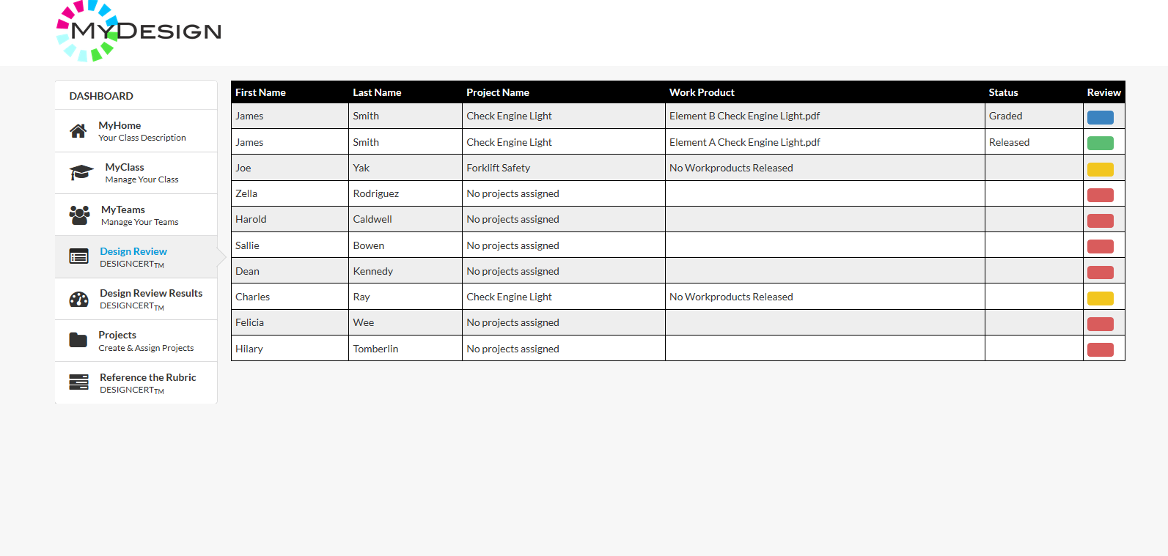
List of Student Work Products
Select from student roster to grade work
Color Code:
Red – no project assigned
Yellow – project assigned; no work released
Green – project assigned; work released and ready for grading
Blue – project assigned; work released and graded; can change grade

Slide 41
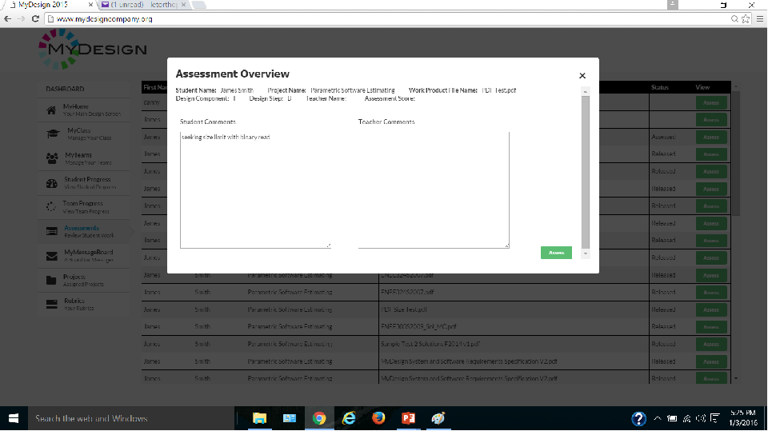
Selected Work Product Metadata Panel
Select to move on to Assessment screen
Overview Panel appears with work product metadata

Slide 42
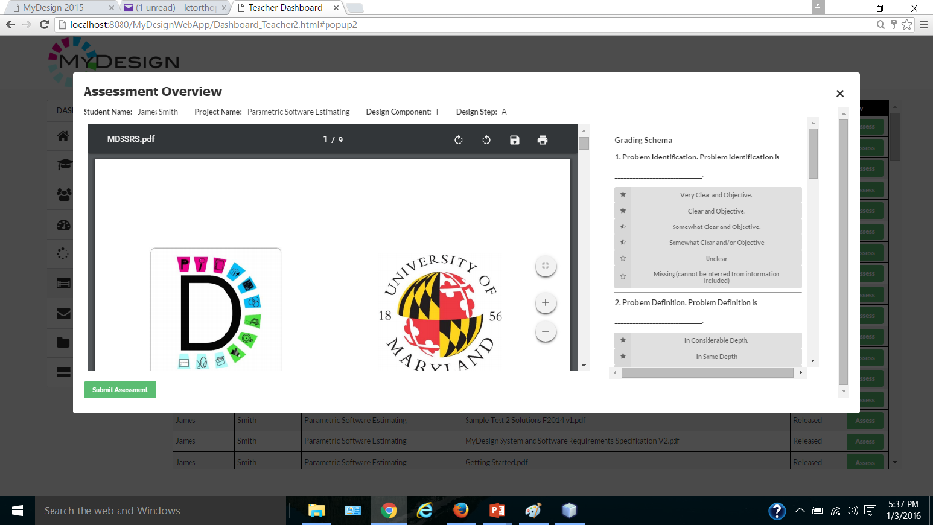
Assessment (Grading) Panel
View Work Product
Select to record assessment and go back to Assessment Overview Panel to enter teacher comments
To assess work product against the rubric, select icon to score 0 – 5 for each of several multiple choice questions based on the rubric

Slide 43
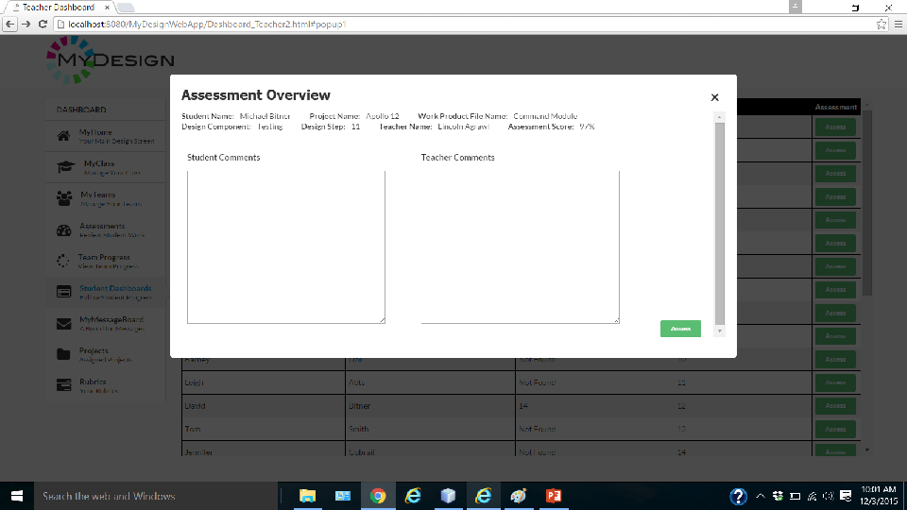
Selected Work Product Metadata Panel
With Assessment Data
Enter Teacher comments and view assessment results
Select to end assessment session and go back to list of student work products on Teacher Dashboard
Assessment Overview panel re-appears with assessment data

Slide 44
Reviewing a Previous Assessment from the Teacher Dashboard

Slide 45
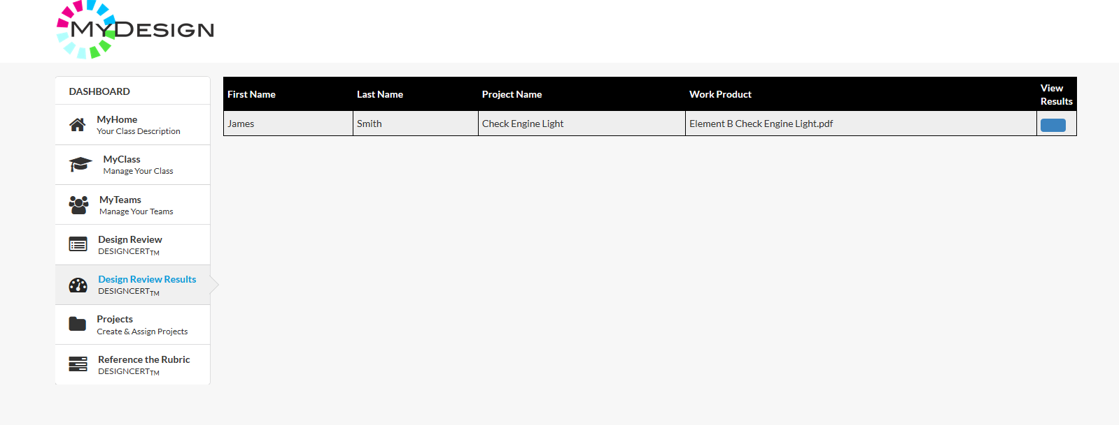
List of Student Work Products Already Graded
All graded work products appear in this table. The Teacher can review a grade by selecting the blue button.

Slide 46
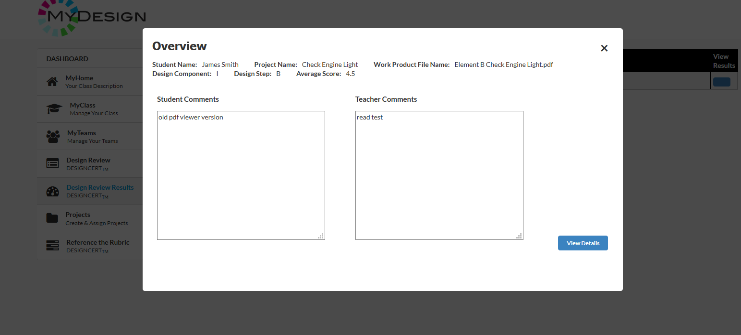
Selected Work Product Metadata Panel
Overview Panel appears with work product metadata, student and teacher comments, and the average grade received against the rubric for this Design Step
Select to view details of the assessment

Slide 47
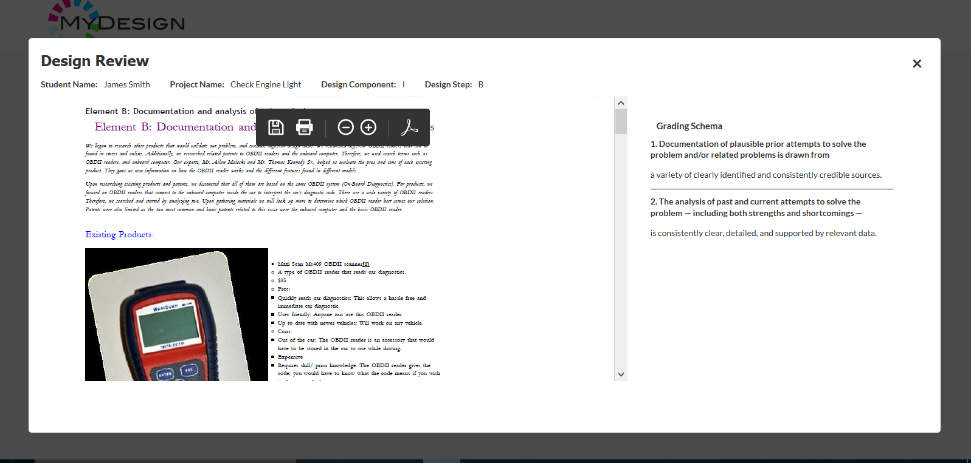
Assessment Panel
Details of assessment received
View Work Product

